Slide 1
VLM Overviews

Slide 2
IDEFICS 2 (Image-aware Decoder Enhanced à la Flamingo with Interleaved Cross-attentionS)
- 8B open-source VLM
- A general multimodal model that takes as input arbitrary sequences of texts and images, and generates text responses
- It can answer questions about images, describe visual content, create stories grounded in multiple images, extract information from documents, and perform basic arithmetic operations
- The performance on Visual Question Answering benchmarks is top of its class size, and competes with much larger models such as LLava-Next-34B and MM1-30B-chat
- Trained on a mixture of openly available datasets for the pretraining: Interleaved web documents (Wikipedia,OBELICS), image-caption pairs (Public Multimodal Dataset, LAION-COCO), OCR data (PDFA (en), IDL and Rendered-text, and image-to-code data (WebSight))
- Fine-tuned Idefics 2 on the concatenation of The Cauldron (an open compilation of 50 manually-curated datasets formatted for multi-turn conversations) and various text-only instruction fine-tuning datasets

Slide 3
LLaVA-NeXT (LLaVA 1.6 / Large Language and Vision Assistant)
- The first attempt to use language-only GPT-4 to generate multimodal language-image instruction-following data
- End-to-end trained large multimodal model that connects a vision encoder and LLM for general-purpose visual and language understanding
- Utilizes the LLaMA model, which is renowned for its efficacy in open-source language-only instruction-tuning projects
- Pre-training for Feature Alignment: LLaVA aligns visual and language features to ensure compatibility in this initial stage
- Fine-tuning End-to-End: While the visual encoder's weights remain unchanged, both the projection layer's pre-trained weights and the LLM's parameters become subject to adaptation. This fine-tuning can be tailored to different application scenarios, yielding versatile capabilities
- LLaVA-NeXT increases the input image resolution to 4x more pixels. This allows it to grasp more visual details. It supports three aspect ratios, up to 672x672, 336x1344, and 1344x336 resolution
- LLaVA-Next compares with SoTA methods (GPT-4V, Gemini, and LLaVA 1.5) on benchmarks for instruction-following LMMs. It achieves improved reasoning, OCR, and world knowledge and exceeds Gemini Pro on several benchmarks
- LLaVA has shown promising results, even approaching the capabilities of the new ChatGPT in some scenarios. To advance further, one interesting avenue is the integration of powerful vision models, such as SAM

Slide 4
Florence 2
- Excels in tasks such as captioning, object detection, and segmentation by interpreting simple text prompts
- Uses the large-scale FLD-5B dataset, consisting of 126 million images and 5.4 billion comprehensive visual annotations
- Despite its small size (0.77 billion parameters), it achieves results on par with models many times larger, like Kosmos-2 (1.6 billion parameters)
- Capable of performing multiple vision tasks with a single model, reducing the need for separate specialized models.
- Compact architecture enables deployment on resource-constrained devices.
- Excels in zero-shot learning scenarios, outperforming larger models.
- Applicable to a wide range of vision and vision-language tasks, from captioning to segmentation.
- However, the FLD-5B dataset, crucial for training and fine-tuning, is not yet publicly available, potentially limiting reproducibility and further research.
- Also, it may not always match the performance of specialized models optimized for single tasks.

Slide 5
GPT-4o (GPT-4 Omni)
- Can understand any combination of text, image and audio input and respond with outputs in any of those forms
- It can respond to audio inputs in as little as 232 milliseconds, with an average of 320 milliseconds
- As measured on traditional benchmarks, GPT-4o achieves GPT-4 Turbo-level performance on text, reasoning, and coding intelligence, while setting new high watermarks on multilingual, audio, and vision capabilities
- GPT-4o has been trained with a knowledge base and is able to respond to questions
- Can analyze images and videos, allowing users to upload visual content that GPT-4o will understand, be able to explain and provide analysis for
- The vision and reasoning capabilities can enable users to analyze data that is contained in data charts. GPT-4o can also create data charts based on analysis or a prompt
- Can remember previous interactions and maintain context over longer conversations
- With a context window supporting up to 128,000 tokens, GPT-4o can maintain coherence over longer conversations or documents, making it suitable for detailed analysis
- Designed to minimize the generation of incorrect or misleading information. GPT-4o includes enhanced safety protocols to ensure outputs are appropriate and safe for users
- 50% cheaper than GPT-4 Turbo

Slide 6
Segmenting the Image

Slide 7
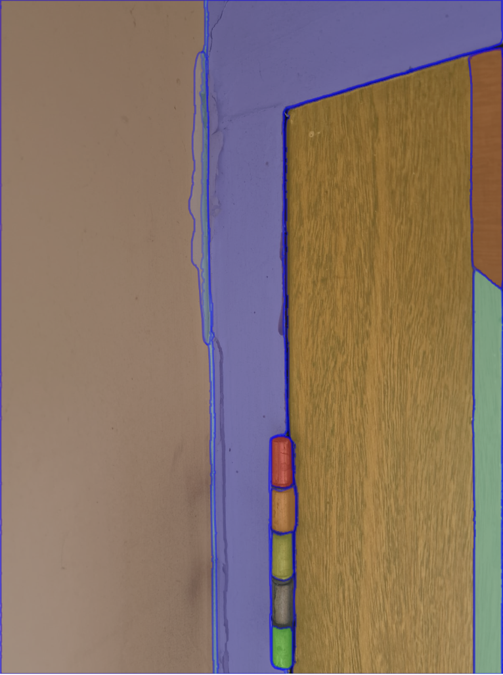
SAM (Segment Anything Model)

Slide 8
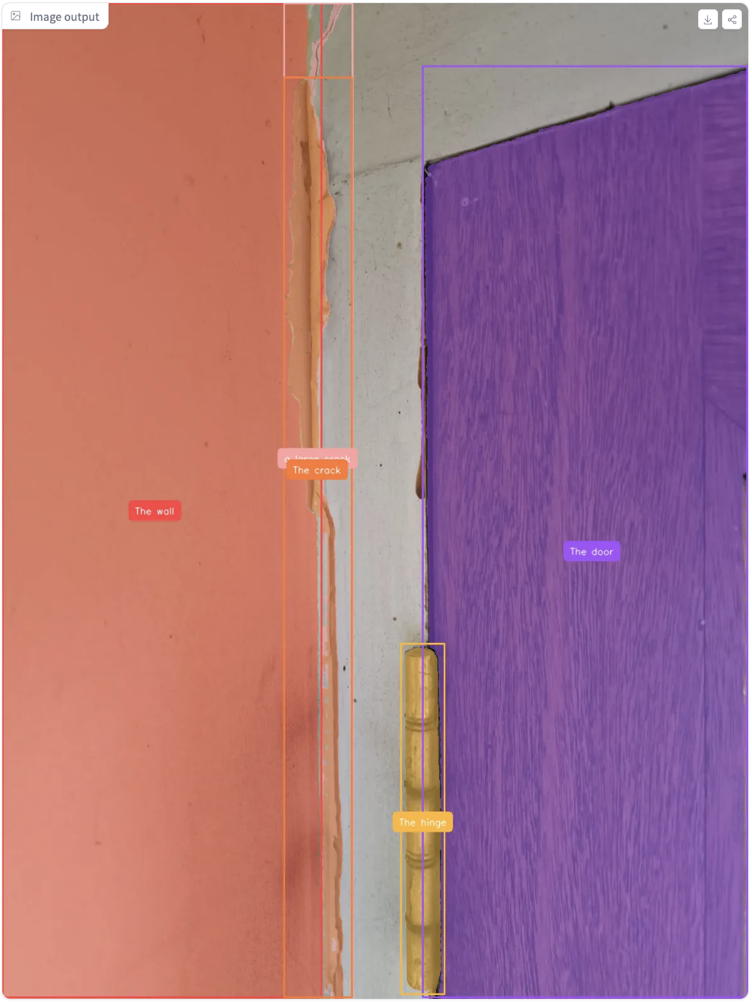
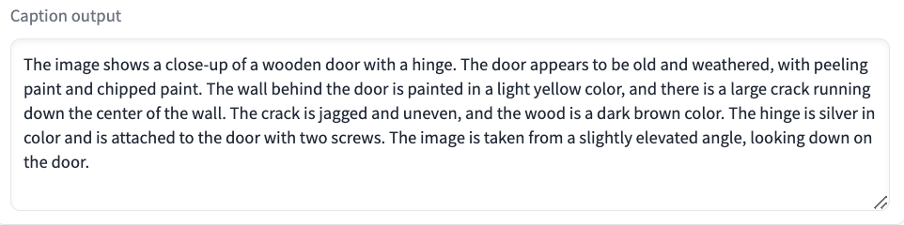
Florence 2 + SAM 2

Slide 9
Identifying the
Defects / Area

Slide 10
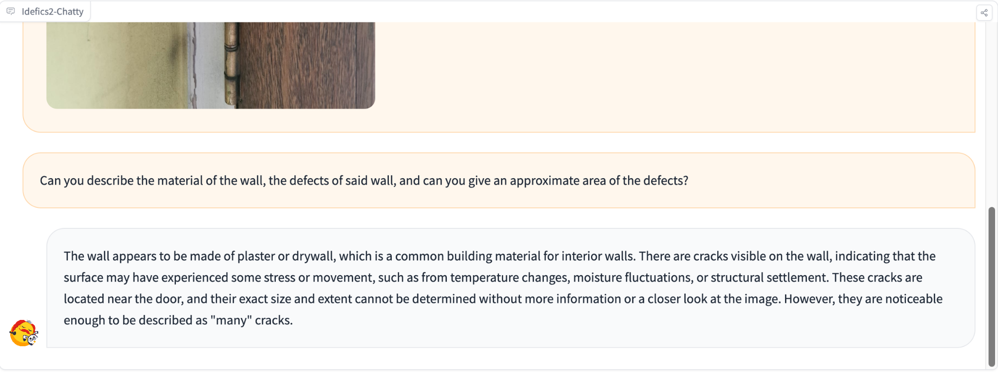
IDEFICS 2: Default Image

Slide 11
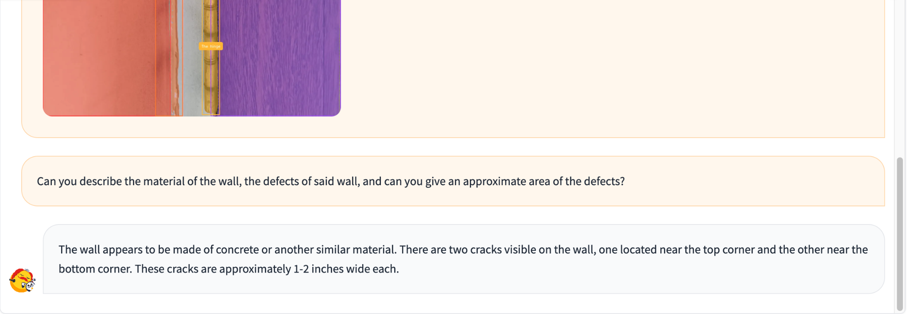
IDEFICS 2: Segmented Image

Slide 12
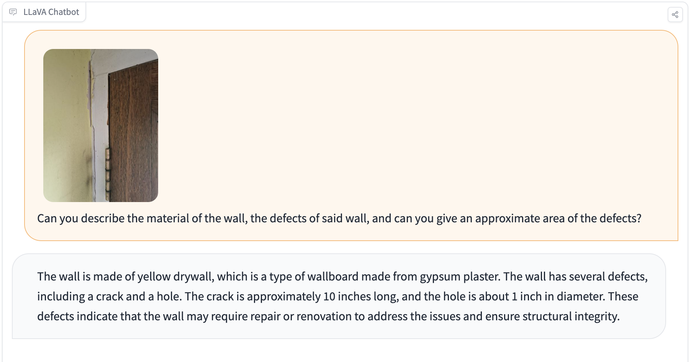
LLaVA : Default Image

Slide 13
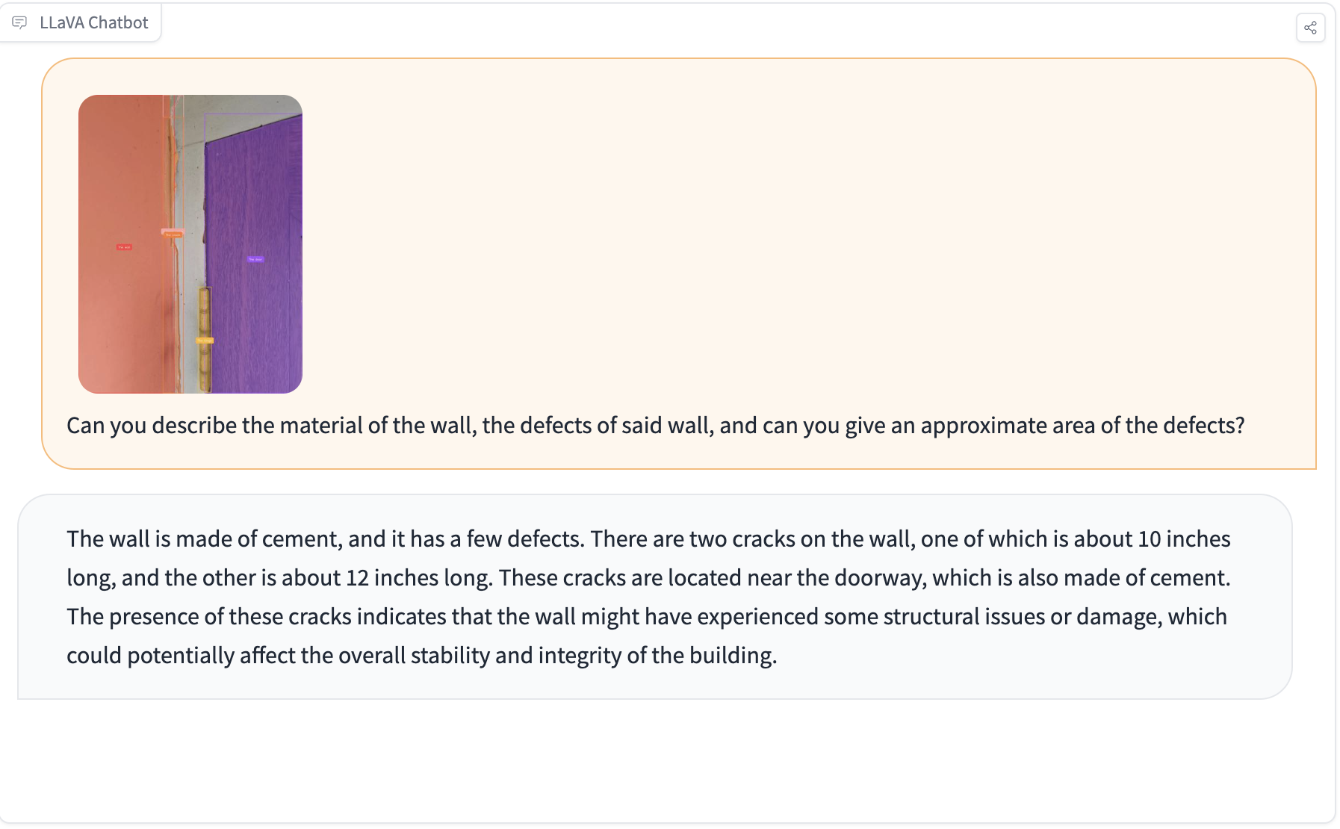
LLaVA : Segmented Image

Slide 14
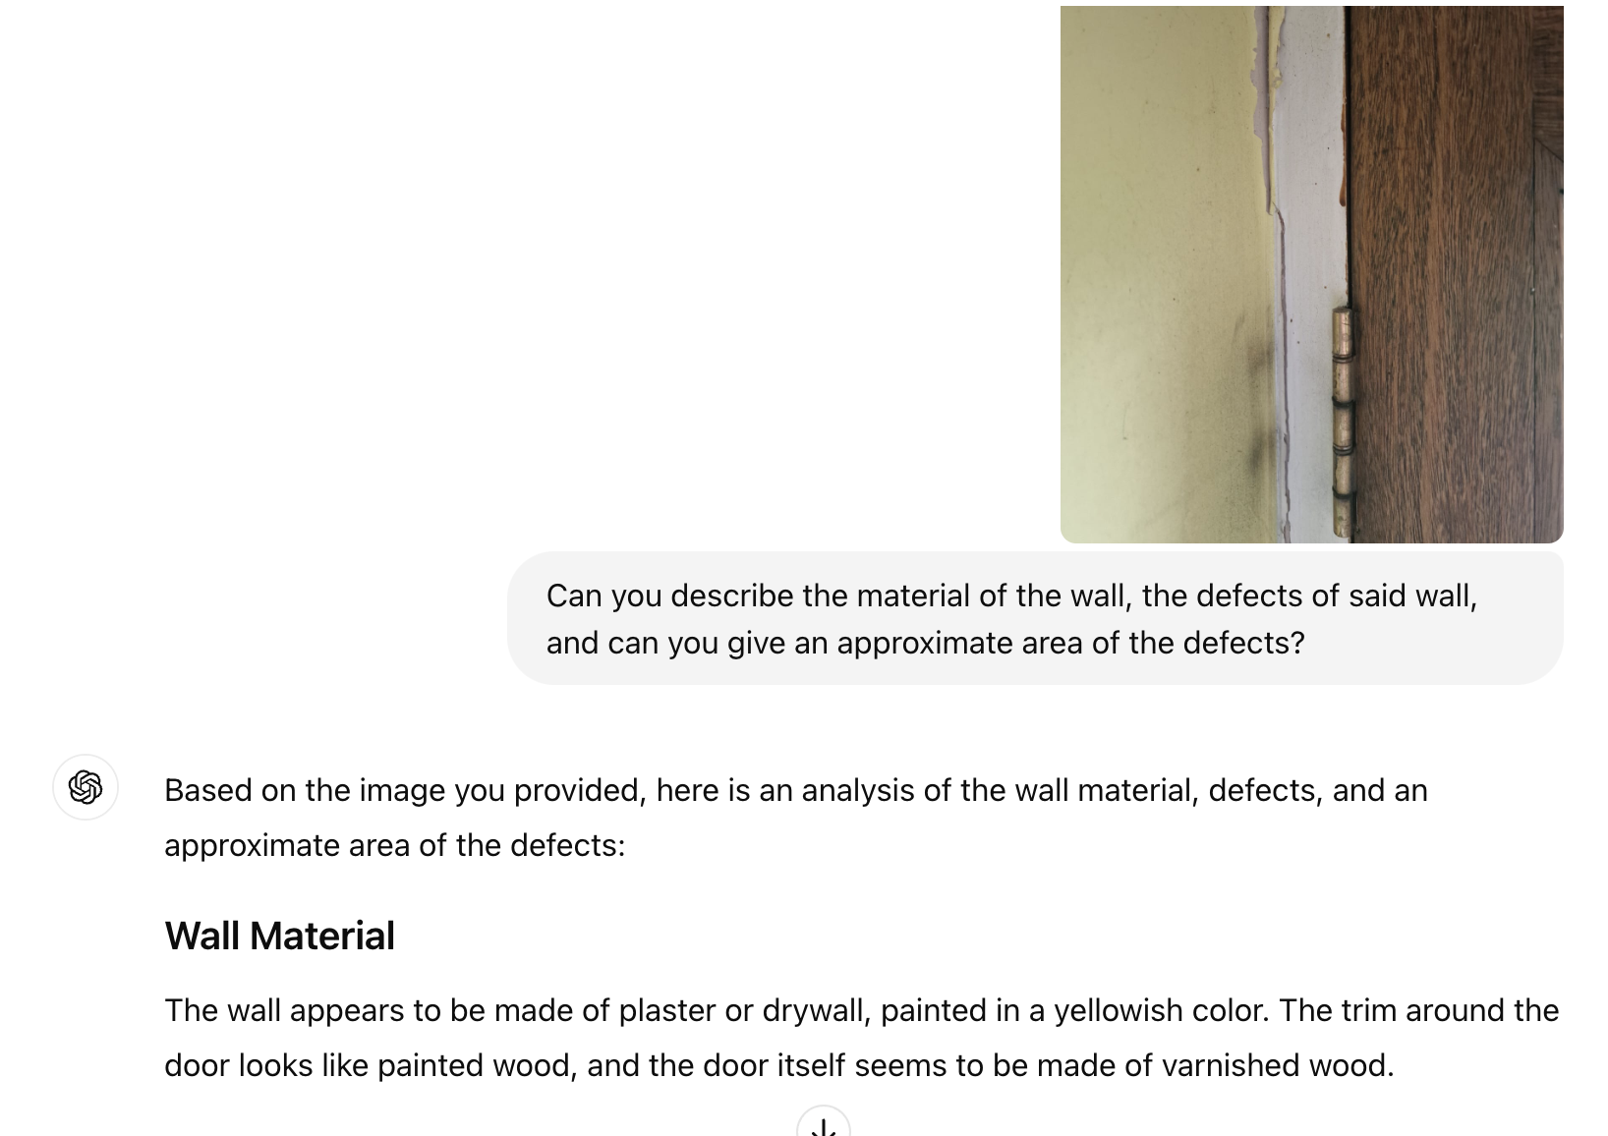
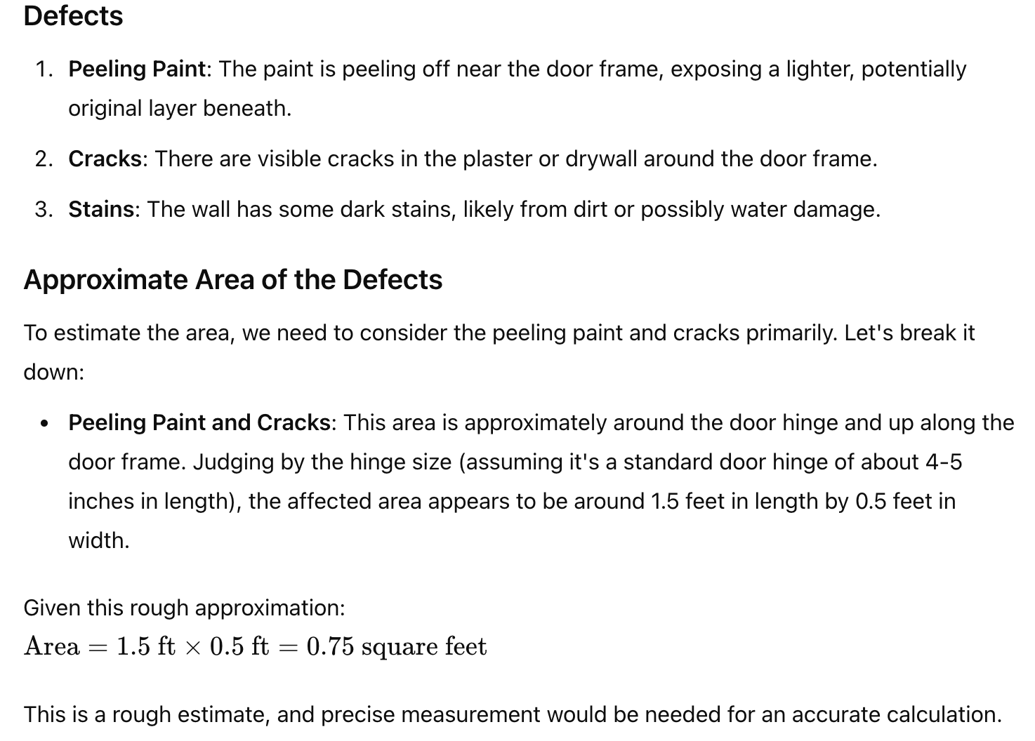
GPT-4o: Default Image

Slide 15
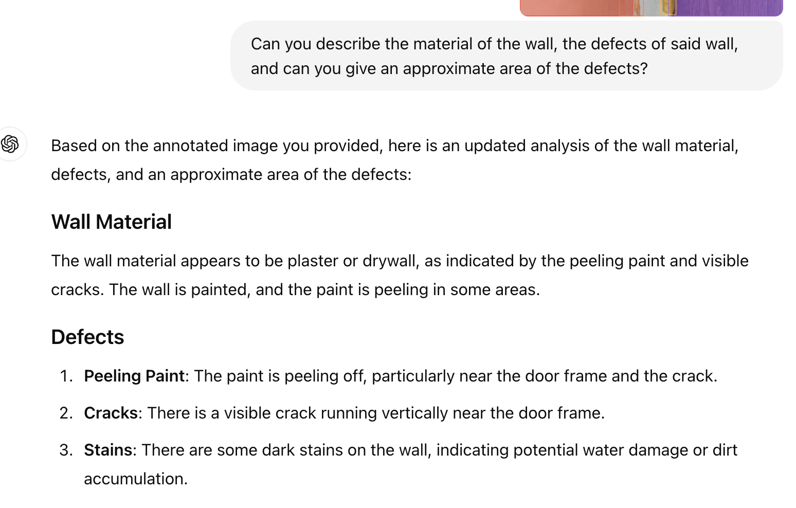
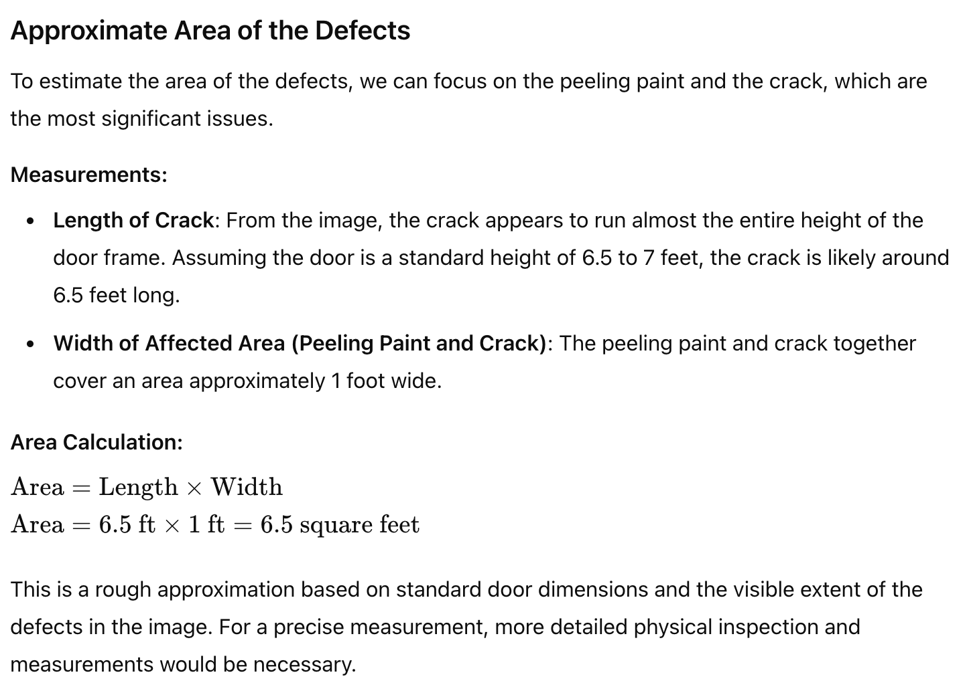
GPT-4o: Segmented Image

Slide 16
Overall Takeaways
- Use Florence 2 and Sam 2 to segment images
- GPT-4o > LLaVa-NeXT > IDEFICS 2 (w/o fine-tuning)
- Possible changes to the ranking with fine-tuning

Slide 17
Continuous Metrics

Slide 18
Possible Metrics
Material Recognition Accuracy: The percentage of correctly identified wall materials out of all material identifications.
Defect Classification Accuracy: The percentage of correctly classified defects out of all defect classifications.
Intersection over Union (IoU): Measures the overlap between the predicted defect area and the ground truth area.
F1 Score: The harmonic mean of precision and recall which indicates the reliability of a model.
Mean Absolute Error (MAE) for Surface Area: The difference between the predicted and actual surface area of defects.

